Slide 1
Pattern Recognition
Chapter 5:
Discrimination functions for pattern classification _part I

Slide 2
Outline
Motivation
Linear Discriminants
Multi-class classification using linear discriminants
Learning discriminants
Perceptron approach
Minimum squared error approach
Notes:
r

Slide 3

Motivation
So far, the approach to the labeled sample problem is :
  Use the given samples to obtain a class description consisting of either a distance metric or probability density function
  Derive decision rule from description(e.g. MICD and MAP)
The decision rule in turn specifies a decision boundary in feature space.
For example, MICD rule and MAP rule have decision surfaces of the form:

Slide 4
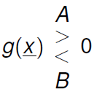
Motivation
The function g(x) is a discriminant function
The two-class decision rule can be written as:
A positive value for g(x) means that the pattern x belongs to class A, while a negative value for g(x) means that the pattern x belongs to class B.

Slide 5
Motivation
Idea: What if we take an alternative approach?
  Assume a particular form for the discriminant functions(e.g., hyperplane)
  Use the given samples to directly estimate the parameters of the discriminant functions.
  Given discriminant funcitons, decision rules and decision surfaces are defined.
What we basically want to do is learn the discriminant functions directly from the samples.

Slide 6

Linear Discriminants
A linear discriminant function can be expressed as:
Where w is the weight vector and w₀ is a threshold.
If we set g(x), we have the equation for a hyperplane, with the decision surface defined for a linear classifier.

Slide 7
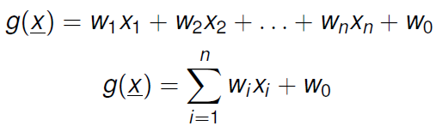

Linear Discriminants
A more explicit way of expressing g(x) to emphasize its linear nature is:
E.g., For a two-class case x=(x₁,x₂), the linear discriminant g(x₁,x₂) can be written as:
Just a straight line equation!

Slide 8
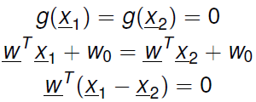
Linear Discriminants
Consider the two class problem with discriminant
g(x)=w^{T}x+w₀
The decision rule can be defined as:
x∈c₁ if g(x)>0 ; x∈c₂ if g(x)<0
The decision surface, defined by g(x)=0, is a hyperplane with the following properties:
  The unit normal vector is w/|w|, since for any two vector x₁ and x₂:
  This shows that w is normal to any vector lying in the plane so that w/|w| is the unit normal.

Slide 9
Linear Discriminants
The decision surface, defined by g(x)=0, is a hyperplane with the following properties:
  The unit normal vector is w/|w|.
  The distance between any x and the hyperplane is |g(x)/|w||
  When g(x)>0, x is said to lie on the positive side of the plane, the side which w points to.
  When g(x)<0, x is said to lie on the negative side of the plane.

Slide 10
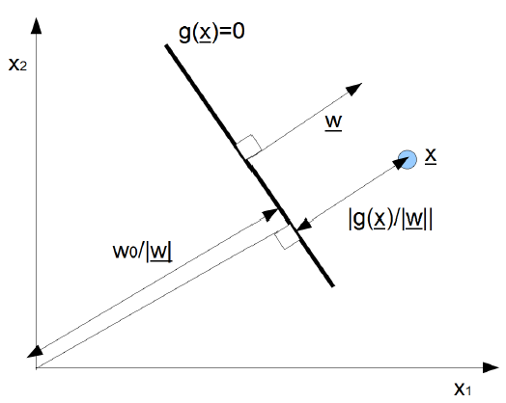
Linear Discriminants

Slide 11
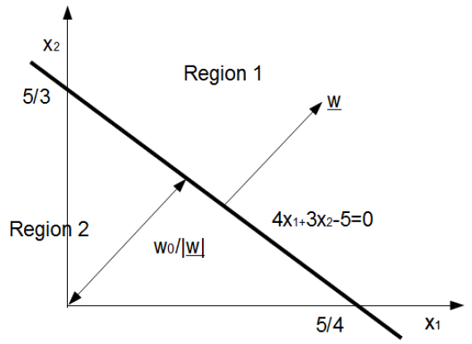
Example
Try to calculate the unit normal vector of the decision boundary and its distance from the origin.

Slide 12
Multi-class case
So far, we’ve only talked about defining decision regions for the two class problem
How do we handle the situation where we have multiple classes(k>2)?
Three possible strategies:
Strategy 1: A linear discriminant can be found for each class which separates it from all other classes:
  If g_{i}(x)> 0 then x∈c_{i}, i=1,……,k
  If g_{i}(x)< 0 then otherwise

Slide 13
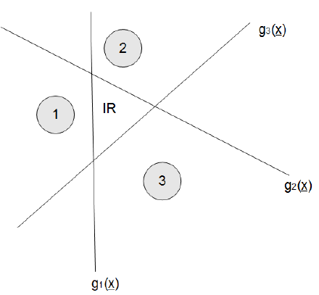
Multi-class case: strategy 1
Quite a few indeterminant areas

Slide 14
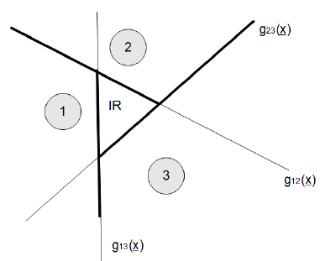
Multi-class case: strategy 2
Three possible strategies:
Strategy 2: A linear discriminant can be found for every pair of classes:
If g_{ij}(x)>0 for all j≠ i then x∈c_{i}, i=1,……,k

Slide 15
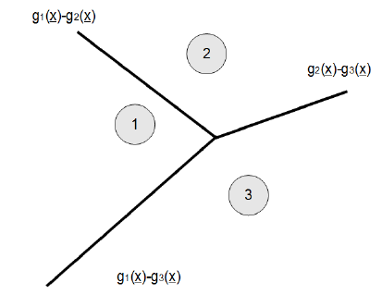
Multi-class case: strategy 3
Three possible strategies:
Strategy 3: Each class has its own discriminant function:
If g_{i}(x)> g_{j}(x)for all j≠ i then x∈c_{i}, i=1,……,k
Notes:
右边的决策边界与左边的决策边界不一定重合！ 但左边的3个交叉点，必定在右边的决策边界上！

Slide 16
Multi-class case
Of the three strategies, only the last strategy avoids producing indeterminant regions.

Slide 17
Learning discriminants
how do we build such a k class linear discriminant classifier?
Suppose that we are given a set of labeled samples for each of the classes which are assumed to be linearly separable in an appropriate feature space.
The goal is to learn appropriate discriminant functions g(x) directly from the labeled samples.
Focusing on the two-class problem, the problem of learning the discriminant is to find a weight vector a such that
  g(x)=a^{T}y>0 when y(and x) is a member of class c₁
  g(x)=a^{T}y<0 when y(and x) is a member of class c₂

Slide 18
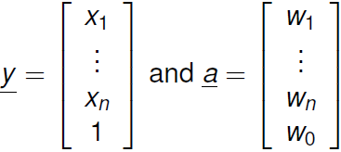
Learning discriminants
If the classes are linearly separable in the original feature space (x), we have:
In y space, the decision surface is a hyperplane which contains the original and has normal vector a/|a|.
Given labeled samples {y₁,…,y_{N}}, the goal is to find a (the solution vector) such that:
  a^{T}y_{i}>0 for all y_{i}∈c₁
  a^{T}y_{i}<0 for all y_{i}∈c₂

Slide 19
Learning discriminants
One way to simplify the problem a bit is to perform normalization by replacing all y_{i} by –y_{i} for all y_{i}∈c₂
By doing so, we can change our goal to finding a^{T}y_{i}>0 for all i! The solution remains the same!

Slide 20
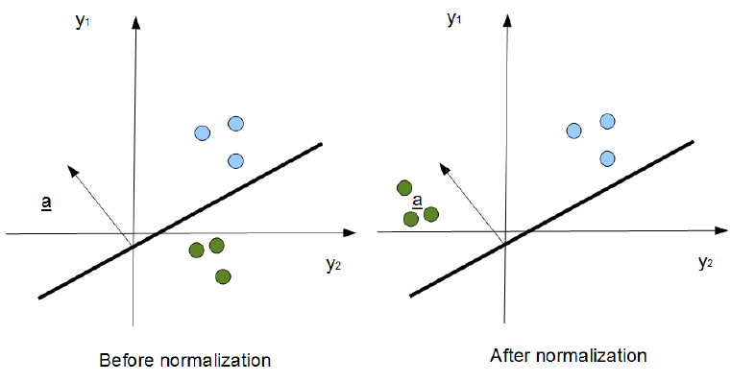
Learning discriminants

Slide 21
Learning discriminants
So how do we find a solution vector a that satisfies our classification criteria?
Trial and error and exhaustive search strategies are impractical for the general N sample n dimensional problem.
A much more efficient strategy is to use iterative methods that use a criterion function which is minimized when a is the solution vector.

Slide 22

Learning discriminants
We here use gradient descent optimization strategies to find a:
Let J(a) be the criterion function
The weight vector at k+1 (a_{k+1}) is computed based on the weight vector at k (a_{k}) and the gradient of the criterion function (▽J(a))
Since ▽J(a) indicate the direction of maximum change, we wish to move in the opposite direction, which is the direction of steepest descent:
Where ρ_{k} is the step size (which dictates the rate of convergence)

Slide 23
Learning discriminants
Here we will discuss two types of gradient descent approaches:
  Perceptron approach: guide convergence based on sum of distances of misclassified samples to decision boundary.
  Minimum Squared Error approach: guide convergence based on sum of squared error
Each comes in different varieties!
  Non-sequential: update based on all samples at the same time
  Sequential: update based on one sample at a time

Slide 24


Perceptron approach
The perceptron criterion may be interpreted as the sum of distances of the misclassified samples from the decision boundary
Where Y is the set of misclassified samples due to a:
a is the solution vector when J_{p}(a)=0

Slide 25

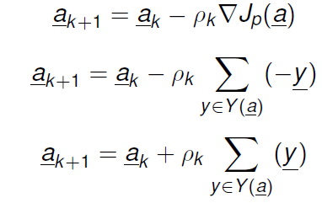
Perceptron approach
The gradient of J_{p}(a) can be written as:
This gives us the weight update formula as:

Slide 26


Perceptron approach
Step1: set an initial guess for the weight vector a₀ and let k=0
Step2: based on a_{k}, construct the classifier and determine the set of misclassified samples Y(a). If there are no misclassified samples, stop here since we have arrived at the solution. Otherwise, continue to Step3.
Step3: compute a scalar multiple of the sum of misclassified samples
Step4: Determine a_{k+1} as
Step5: Go to step2.

Slide 27


Variations on Perceptron approach
Fixed-increment: ,constant step size.
Variable-increment: ,decreases as number of iterations increases to avoid over-shooting solution.
Sing sample correction: Treat samples sequentially, change weight vector with each misclassification.

Slide 28


Sequential Perceptron approach
Step1: set an initial guess for the weight vector a₀ and let k=0
Step2: based on a_{k}, construct the classifier and determine the set of misclassified samples Y(a). If there are no misclassified samples, stop here since we have arrived at the solution. Otherwise, continue to Step3.
Step3: compute a scalar multiple of the kth misclassified sample
Step4: Determine a_{k+1} as
Step5: Go to step2.

Slide 29
Sequential Perceptron approach
This sequential form can be viewed as reinforcement learning for machine learning.
By combining perceptron classifiers until multi-layered networks, what we end up with are what we commonly refer to as neural networks!

Slide 30
Example (do that now)
Suppose we are given the following data:
y1=(4,-1);y2=(2,1) belong to class c1 and y3=(5/2,-5/2) belong to class c2.
Let the initial guess be a0=(0,0), and ρ_{k}=1 for all k.
Use the standard perceptron approach to learn a solution!
Use the sequential perceptron approach to learn a solution!

Slide 31
Minimum squared error approach
One issue with the perceptron approach is that if the classes are not linearly separable, the learning procedure will never stop since there will always be misclassified samples!
One way around this is to terminate after a fixed number of iterations, but the resulting weight vector may or may not be appropriate for classification.
Solution: what if we use a different criterion that will converge even if there are misclassified samples?
The minimum squared error criterion provides a good compromise in performance for both separable and non-separable problems.

Slide 32


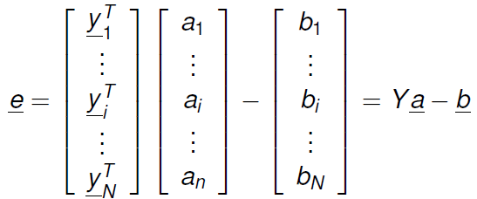
Minimum squared error approach
Instead of solving a set of inequalities:
We can obtain a solution vector for a set of equations:
Let the error vector e be defined as:

Slide 33
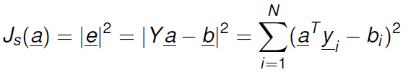
Minimum squared error approach
Instead of finding a solution a that gives no misclassifications, which could be impossible if it is not a linearly separable problem, we want to find a solution a that minimizes |e|²
This gives us the following sum of squared error criterion function:

Slide 34

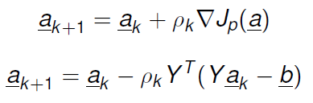
Minimum squared error approach
The gradient of J_{s}(a) can be written:
This gives us weight update formula as:
Notes:
实际上，直接令导数为0，可以直接利用矩阵的伪逆求出参数向量！

Slide 35
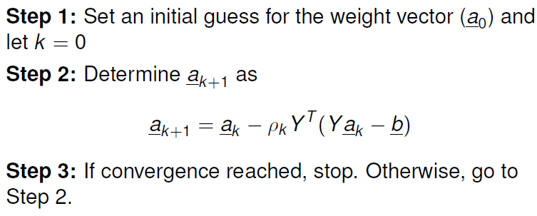
Minimum squared error approach

Slide 36
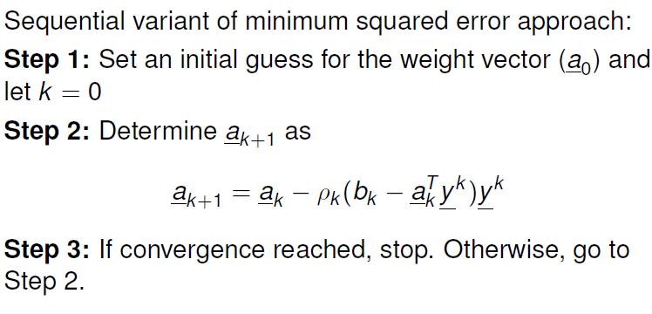
Minimum squared error approach

